Slide 1
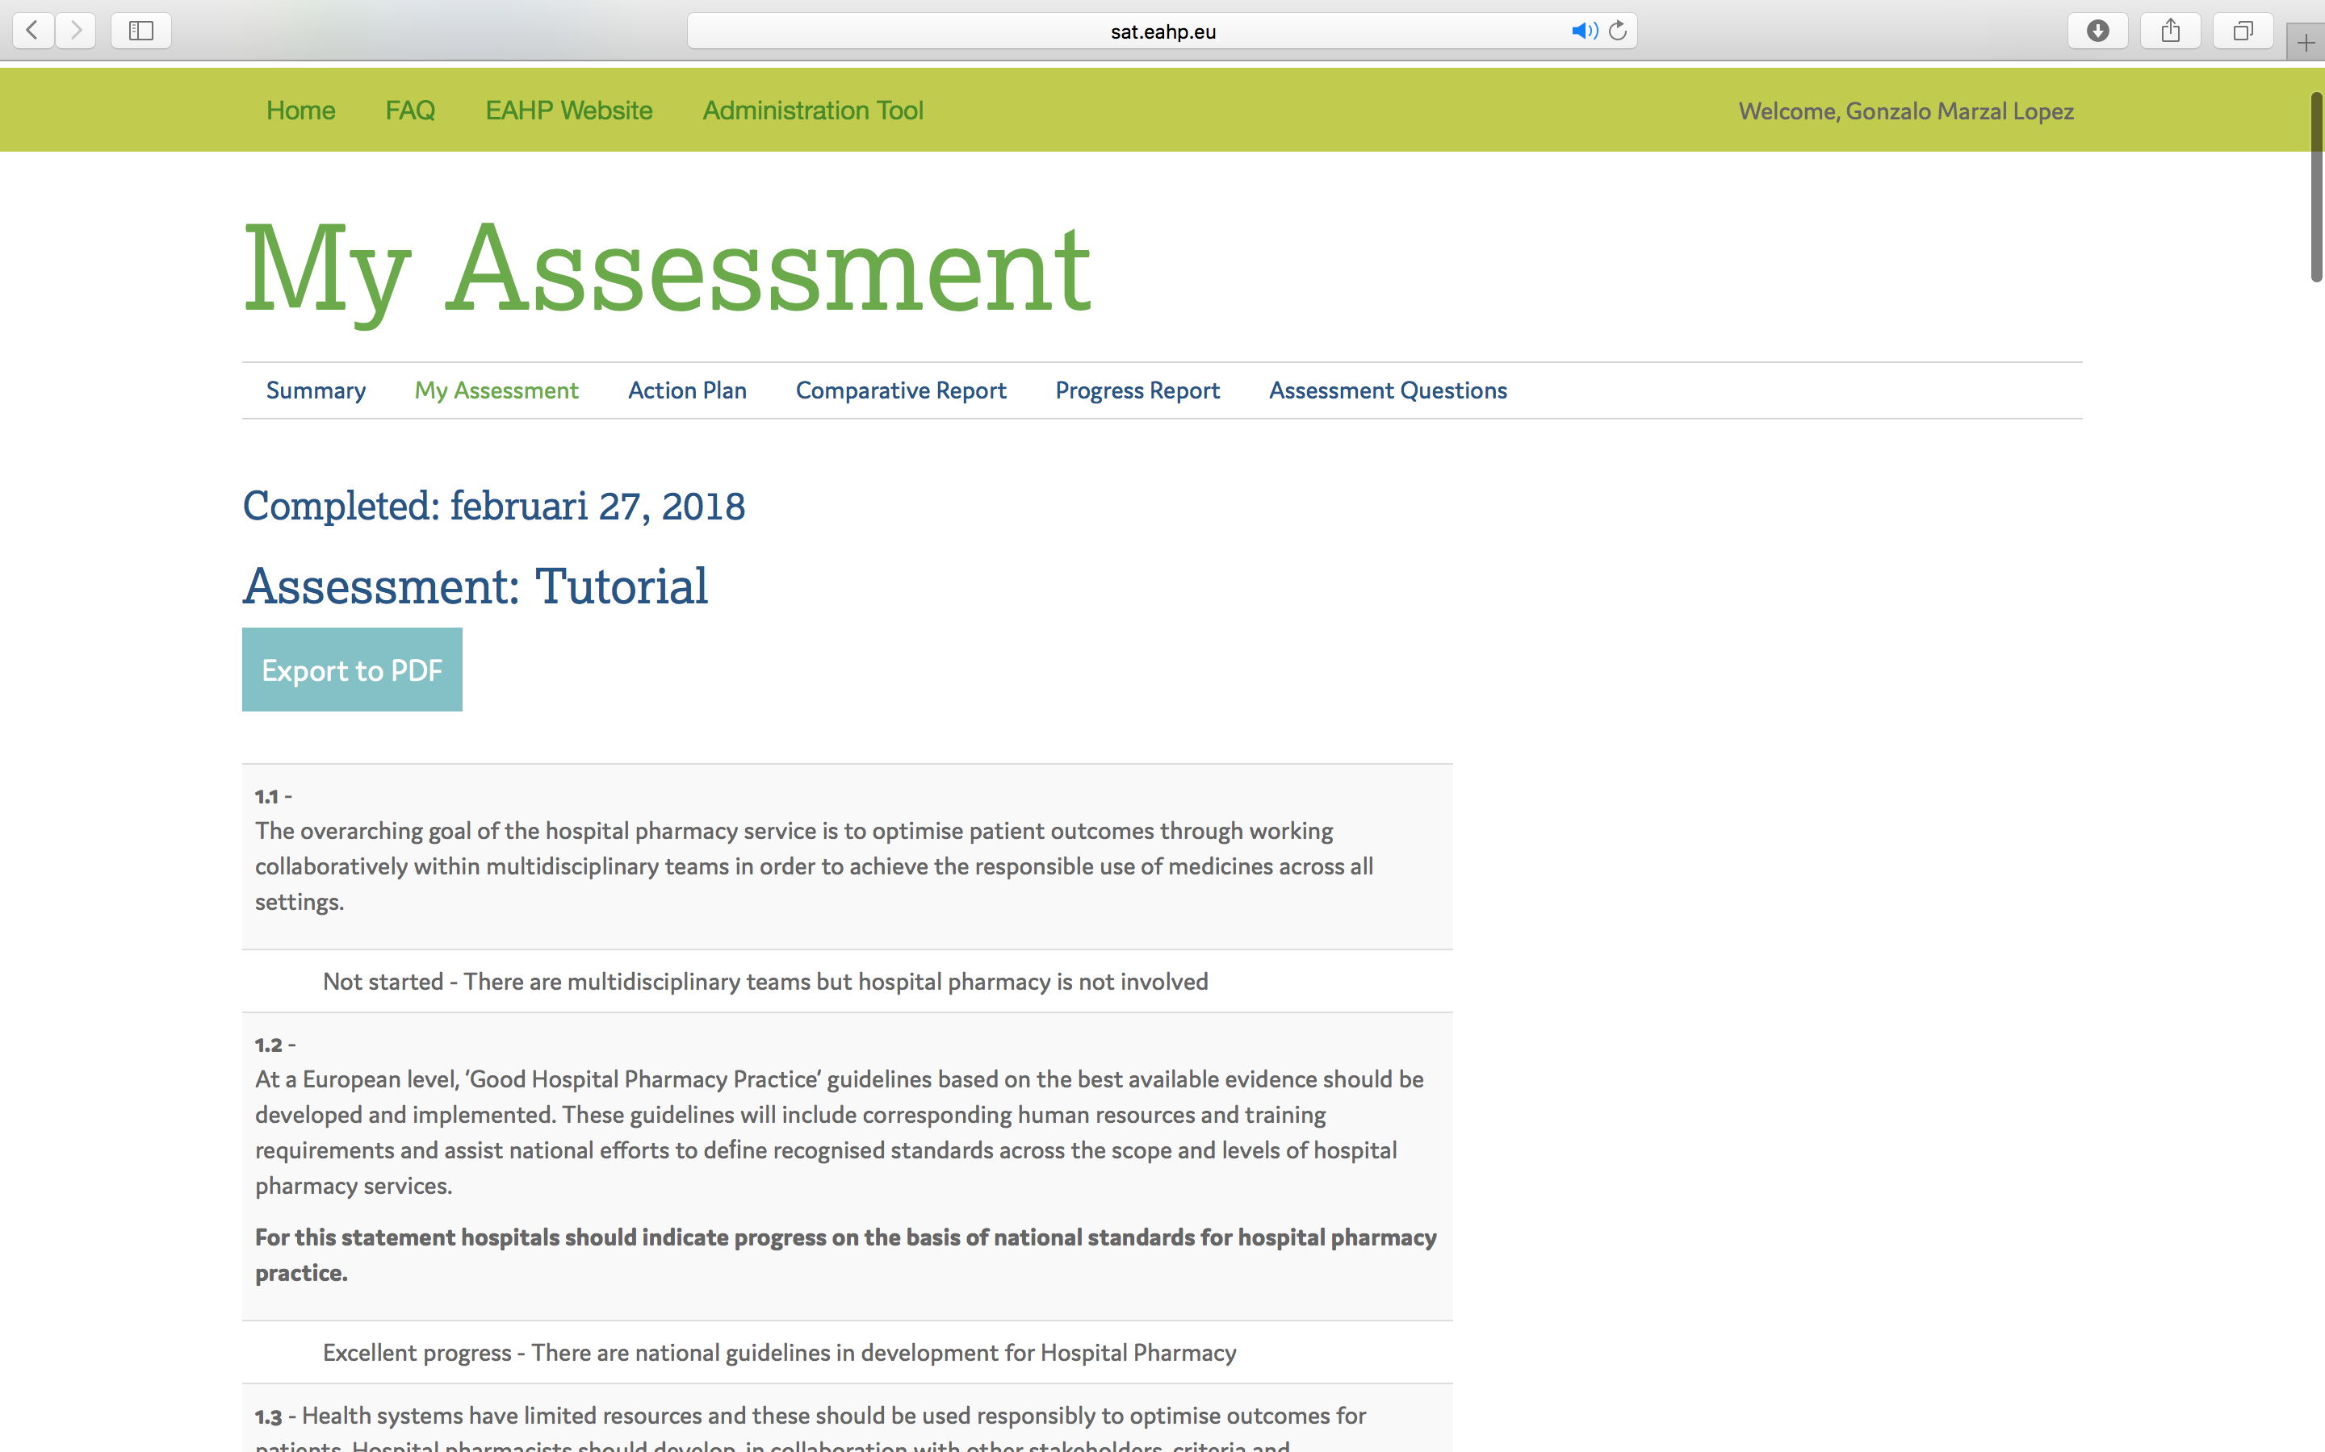
SAT Scrrenshot

